Slide 1
AI for Games
Finite State Machines

Slide 2
What is a state machine?
A Finite State Machine (FSM) represents an objects behaviour as chunks (or states)
It also represents the transitions between those states
Example:
A light switch has two states
Off and On
You cause a transition between the two by flicking the switch up or down.
Notes:
FSMs come from automata theory, which is a branch of computer science.
Formally, an FSM is a mathematical construct – but for games AI, we don’t need to get into the nitty gritty of the maths (it’s really not useful to us). So we’ll stick with the definition offered up by Buckland, “an FSM is a device, or a model of a device, which has a finite number of states it can be in at any given time and can operate on input to either make transitions from one state to another or to cause an output or action to take place. A FSM can only be in on state or another at a time.”
Let’s look at an example: If we were to build a state machine for a light switch we have two states – off and on. The transitions between these two states is straight forward, it is the flicking of the switch from one position to another. There is no output from the off state, but the on state allows electricity to flow through as an ouput (and hence, the light turns on).
A more game related example could be a simple AI in an FPS: We have a lot more states, even for a simple entity; Idle, FindHealth, FindAmmo, FindTarget, FireAtTarget
State machines are the bread and butter of AI techniques and their usage is shrinking in games AI as other techniques arrive that offer more flexibility.

Slide 3
Benefits of an FSM
Straightforward to implement
Easy to debug
Intuitive and flexible
Relatively cheap to process
Notes:
FSMs are easy to implement – many of you may well have implemented one without even realising it. The most basic structure of an FSM is just a series of if and else statements, there are a number of more complicated, but more flexible, approaches and we’ll talk about them shortly!
Compared to a number of other techniques, state machines are easy to debug – as you can only be in one state at a time, just adding some logging statements allow you to quickly pin down which state (or sequence of states) is causing unexpected behaviour.
Breaking down behaviour into states is straight forward, we don’t do it naturally, but it’s a process that is easy to for us as humans to understand and undertake. FSMs are also easy to visualise – let’s draw out that simple AI for an FPS quickly:
Idle – transitions to FindTarget, FindHealth, FindAmmo
FindTarget – transition to Idle, FireAtTarget
FindHealth – transitions to Idle
FindAmmo – transitions to Idle
The flexibility of state machines means adding another state is really straightforward.
Because there’s no complicated processing going on under the hood, state machines are amongst the cheapest approaches to behaviour modelling we can use in games.

Slide 4
Downsides of an FSM
Can be difficult to maintain
They can lead to predictable behaviour
Require full knowledge of the modelled system
Notes:
You can end up producing a spaghetti system, especially as a state machine grows; careful planning of your implementation can help alleviate this but it will always be a risk as behaviours become more complex. This sort of spaghetti mess makes the entire system difficult to maintain and even more difficult to extend.
State machines come in two varieties; deterministic and non-deterministic; a system is deterministic if we can predict the resultant transition from any given input to a state. Meanwhile, a non-deterministic state machine is not predicable, multiple inputs may be received at various times and the state transition cannot be known until all those inputs have been received. Depending on the sort of game we’re making, we will need to decide whether or not predictability is something we want to avoid.
They should only be used when a systems behaviour can be fully decomposed into separate states, with well defined conditions for state transitions, if this cannot happen, than a state machine is not suitable for the system.

Slide 5
Notes:
All states should be kept as generic as possible – this allows you to use a fairly small set of states across a wide range of entities.
Using an enumeration is a very basic way of representing a set of states, we could also use straight numbers or strings if we wanted to.
Ultimately, we want to find a better way of representing the states.

Slide 6
Notes:
As I said earlier, the easiest implementation of a state machine is a chain of if statements – this code is just an example, so we’re missing lots of other bits that would make it more complicated to break down. I’ve also skipped the Die state, which did not add anything to the demo!
A switch statement would also work here, but it does nothing to improve our implementation other than tidying up the code a little.
Can anyone see issues with this setup?
-- quick to lead to spaghetti code, the more states we add the more code we have to implement for each state to deal with transitions.
-- What if we want to have actions that occur on state entry or exit?

Slide 7
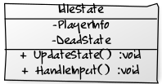
Notes:
A better approach is to build our states into classes – with each state represented by an individual class.
If we write them correctly, they can be completely encapsulated and could be run for any given entity in our system (this is sometimes harder than you might think)
Our state machine (AI entity) then has a pointer to a current state object and calls the update function every frame.
We need to be careful about how we store and represent our states – we want to avoid dynamic allocations as much as possible, especially during gameplay.

Slide 8
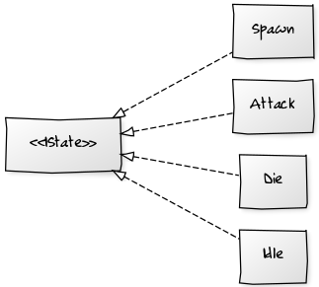
Notes:
One of the preferred methods of producing a state class is to create an interface – which is a class that doesn’t have any implementations, but does provide a set of functions that any class that inherits from the interface has to implement.
This is great because we know that if a class has inherited from an interface, it *has* to have the functionality implemented, so we have reliable methods we can call on those objects and we know they’ll do *something*
Note though that because we’re relying on engineers (or ourselves) to implement the functionality as intended, we may not always get what we expect in terms of behaviour!
Ie, we could have an interface function that is called “HandleInput” – but one objects implementation of it does more than just handle input (maybe it does some other piece of game logic).
In c++ we create these by flagging a class as “abstract” or “purely virtual” by making sure that any functions are not implemented by assigning them a value of 0:
virtual void HandleInput(*Input) = 0;
Trying to instantiate a class that contains an abstract method will cause the compiler to throw an error.
Each class that inherits from the interface can have their own local variables, but the interface itself cannot provide any that are not static.

Slide 9
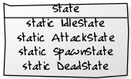

Notes:
We have two approaches to storing our states in this sort of model:
We can either store instances of our states as static variables in the base state interface (remember that interfaces can only have static variables)
This is great, as it means we only instantiate them once right at the start of our application (because they’re static, the compiler puts them into a lump of “read only” memory early on)
But, what if the states contain instance specific information?
DeadState may say how long it takes for a dead entity to be despawned and maybe that is variable between entities.
In that case, we can’t have single static instances, every time we changed the despawn timer for a given entity it would change for all our entities!
So we need to shift the ownership of the states from static members of the interface to instantiated on the fly when needed
This does bring in dynamic allocation, which is a bit bad, but we’ll live with it for now.
We need to make sure we *free* the outgoing state
We can do that in our state machines update function
We may also want to handle actions that occur when we enter or exit a state.
Using a class makes this as easy as having an enter and exit function; the enter function is called when we change *To* the state, the exit function is called before we leave the state (ie, before we replace the current state value in the state machine).

Slide 10
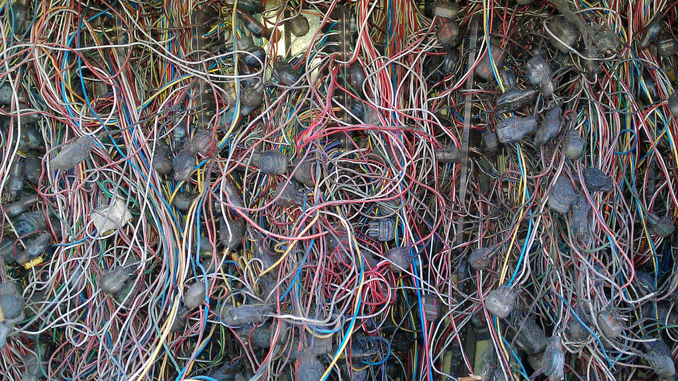
Notes:
This is a pretty good representation of what happens when you try to use a basic state machine for a more complicated task.
We have one state machine that controls an agent, all movement and weapon control.
If we want it to move and fire at the same time, we need a new state, if we want it to jump and fire? Another state.
If we think of the number of states for movement as m and the number of states for a weapon to be n, then we end up with m * n states if we want to have a single state machine control them all.
By using concurrent state machines, we reduce that to two separate lists of states, so m + n.
There may be occasional times where two states need to interact (say we can’t fire a gun when we’re swimming…) but that’s a relatively trivial if statement on the other machines state.
As we develop our states, we may well find ourselves with a series of states that are similar – maybe walking, running and standing and we can jump from any of those states (assuming we’re on the ground).
So we produce a base state that handles jumping (onground), all of our other states inherit from that class.
This means we can chain any input we don’t handle in our inherited state back to the parent state.
So OnGroundState handles input for jumping, in WalkingState we can use a call to OnGroundState::HandleInput(input) to push inputs we don’t handle (such as jump) up the chain
Doing this saves us having to handle a broad cross section of common inputs in all of our child states – so we get to write code once (yay!)

Slide 11

Notes:
We can also work some magic in terms of how we manage our states and state machines – as it stands, states have no _memory_, state machines rely on the states to know what to transition to. But what if we wanted to have a memory?
By using a *stack* of states, we can just pop the most recent stack off the top of the list and return to the last state we were in.
So we could have idle as a base state, when we move, we push the moving state on top of the stack, when we stop, we pop it off to return to idle.
We can retain the replacement of states, allowing us to keep the old behaviours – but the addition of the stack allows us to have almost temporary states.
Another change we can make is to create hierarchies of state machines, so individual states can be entire state machines themselves. This allows us to have generic activities as low level states (say, “Patrol”) which contain entire state machines that govern the agents behaviours while they are in that state.
If we use a stack of state machines, then we can effectively pop our way back out of any given machine all the way back to “default” (so probably our most idle behaviour)

Slide 12
Portfolio Assignment
Implement a Finite State Machine in C++
Create a folder in your GitHub repository called “fsm” and work in there
Remember to use branches!
You have two weeks
You can attempt as complicated a state machine implementation as you wish
Have the FSM output status to the console

